Slide 1
Schrodinger Cat
Rakhee Bhojakar, Chelsea Brooks, Erik Fox, Dhakshayini Koppad, Jamie Williams

Slide 2
Schrodinger Cat
Project Summary
Project Contribution
Before/After Photos
Text to Speech
Facial/Object Recognition
Face/3D Printing
Servos

Slide 3
Project Summary
Schrodinger Cat, aka Einstein robot, is one of the oldest robots in the lab. Schrodinger Cat is made up servos for the body and wheels. The servos are controlled with the arduino. We added a raspberry pi to add vision, speech, and a screen to the robot.

Slide 4
Project Contribution
Text to Speech – Chelsea
Face and Object Detection - Rakhee
Servos - Jamie
Omni-wheel Control and Hardware - Dhakshayini
3D Printing/Screen Face - Erik

Slide 5
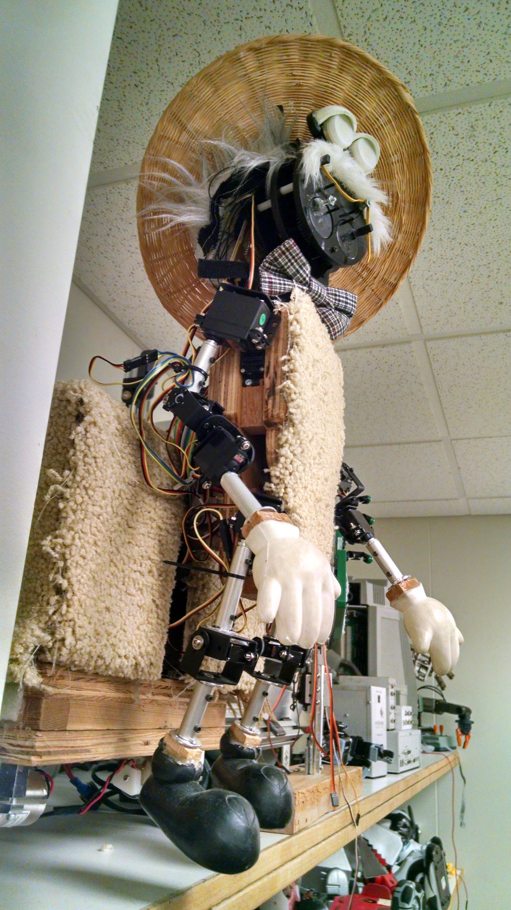
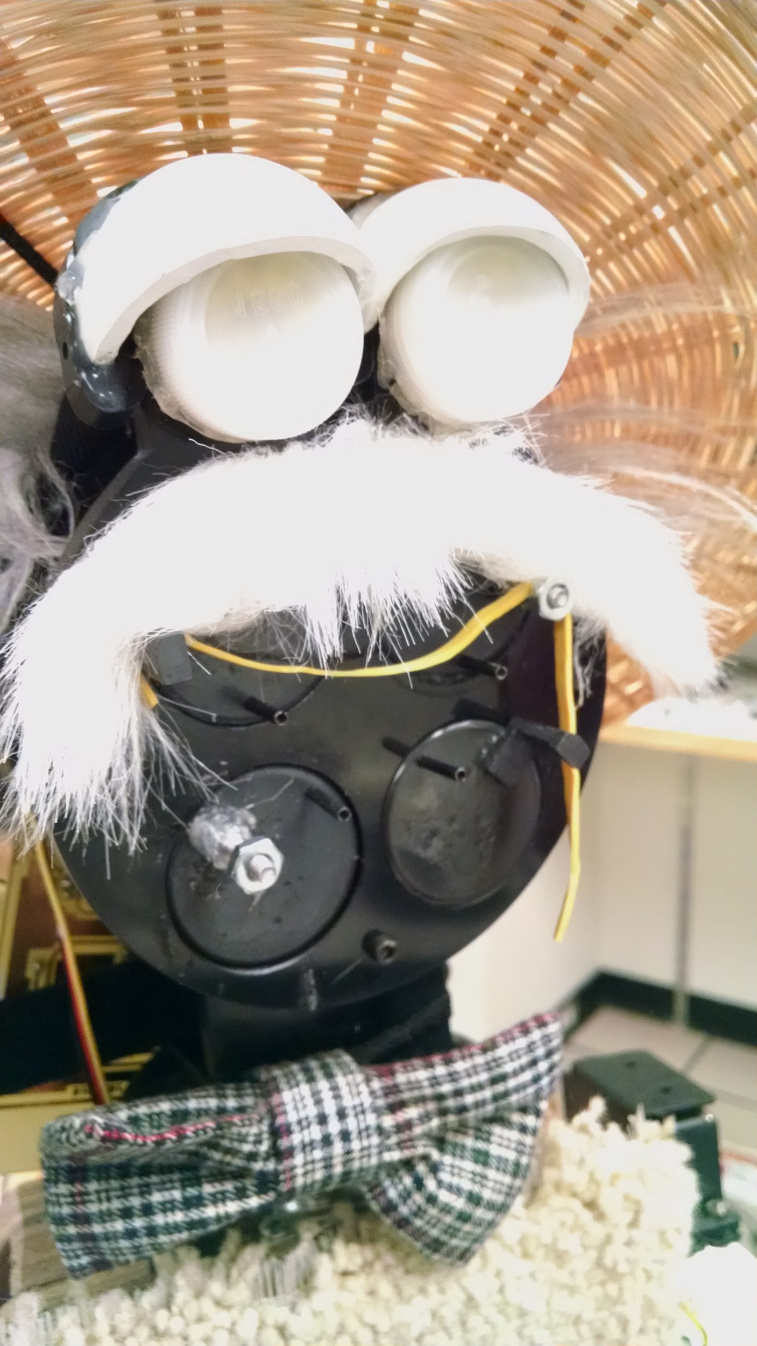
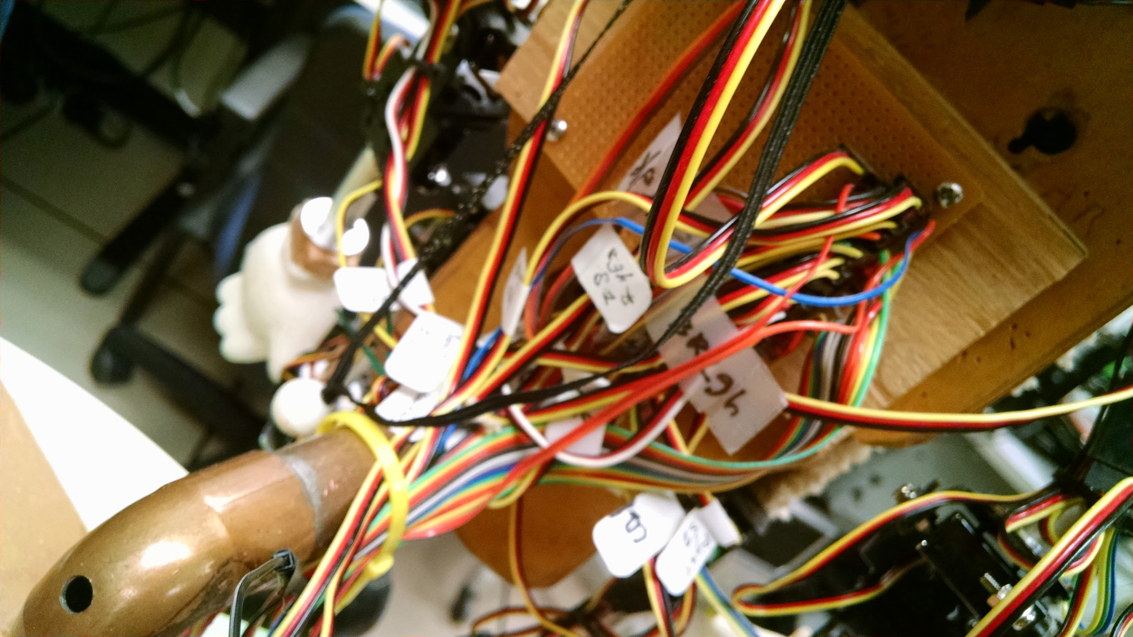
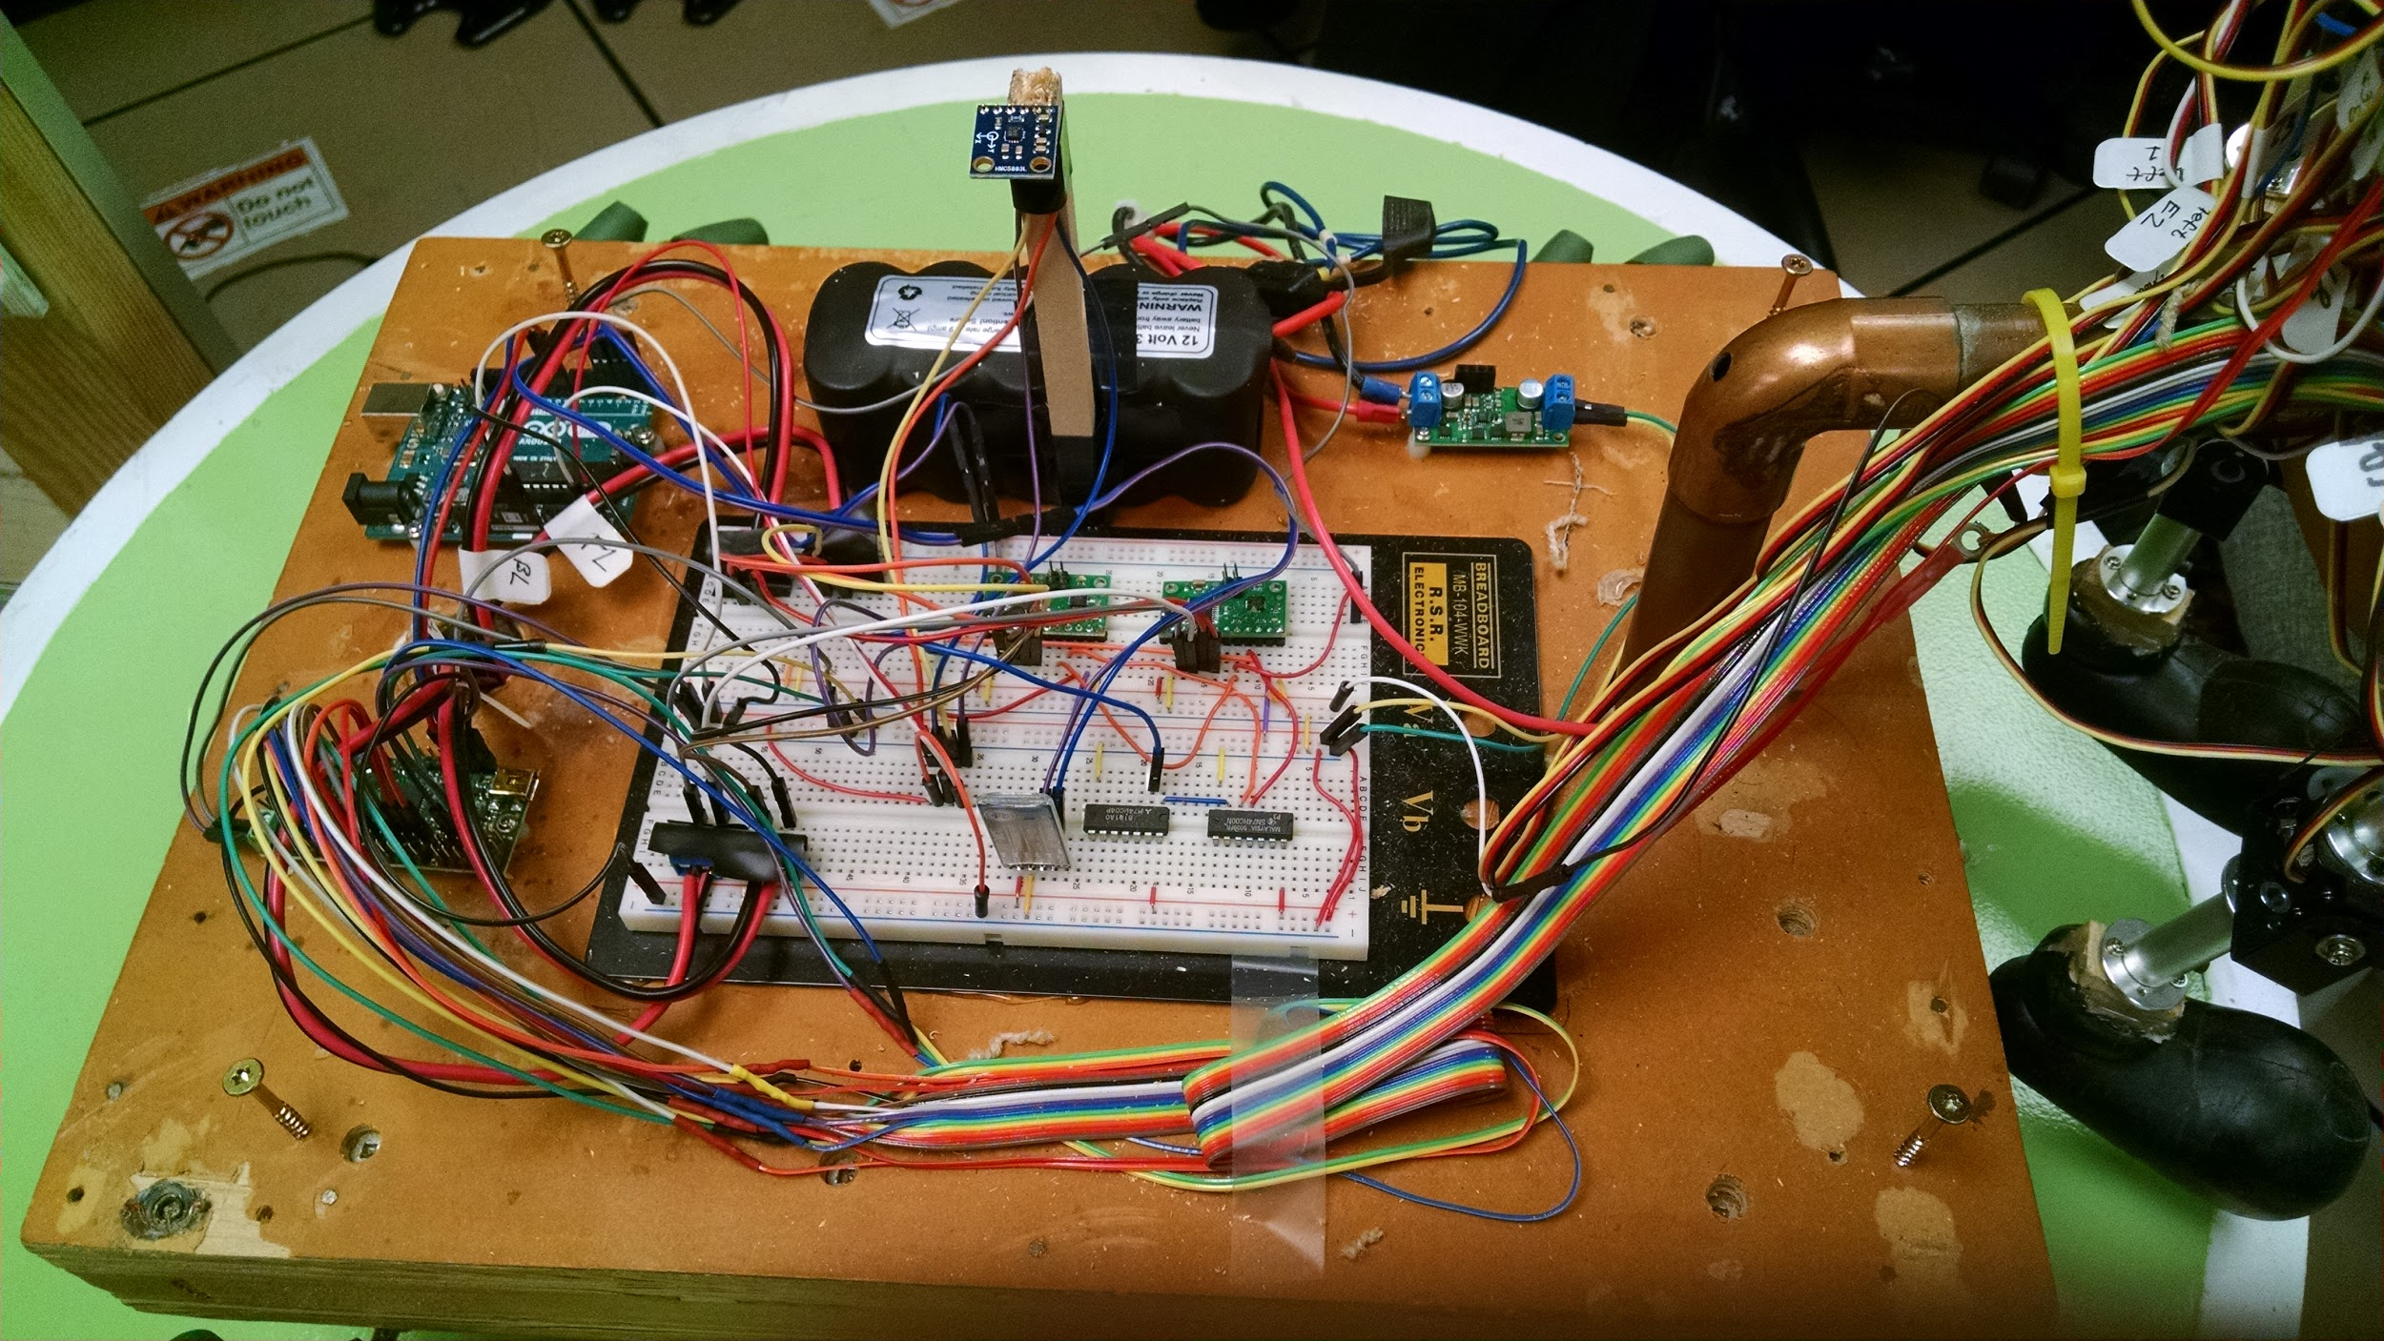
Before Pictures

Slide 6
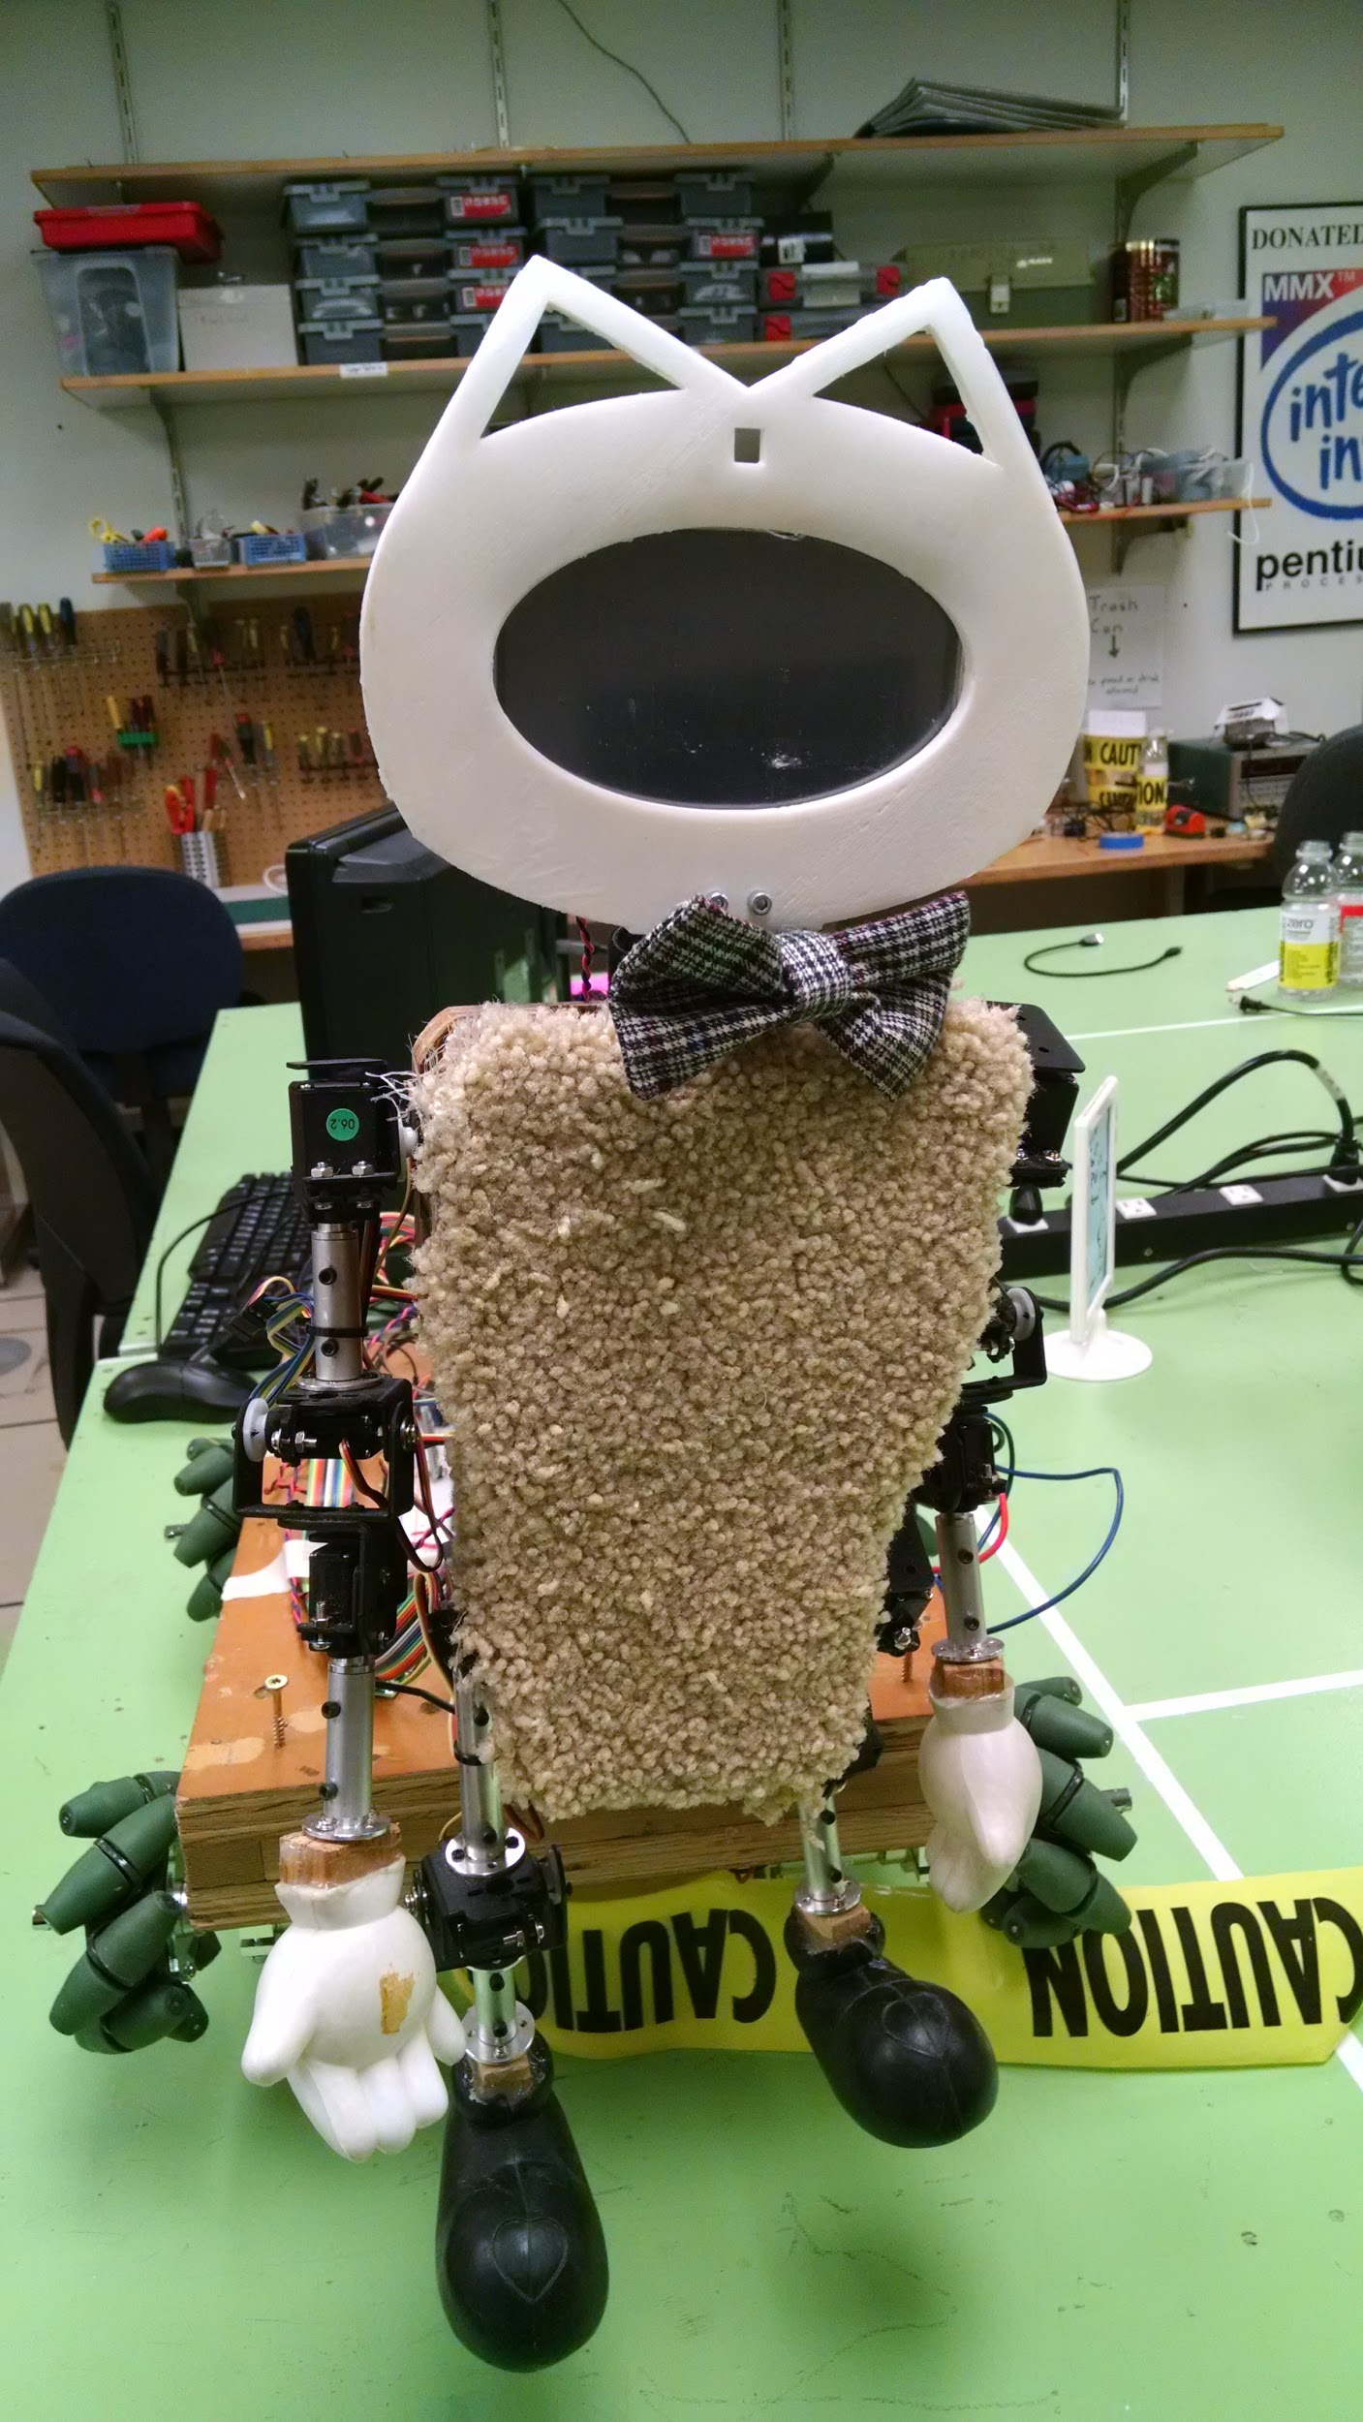
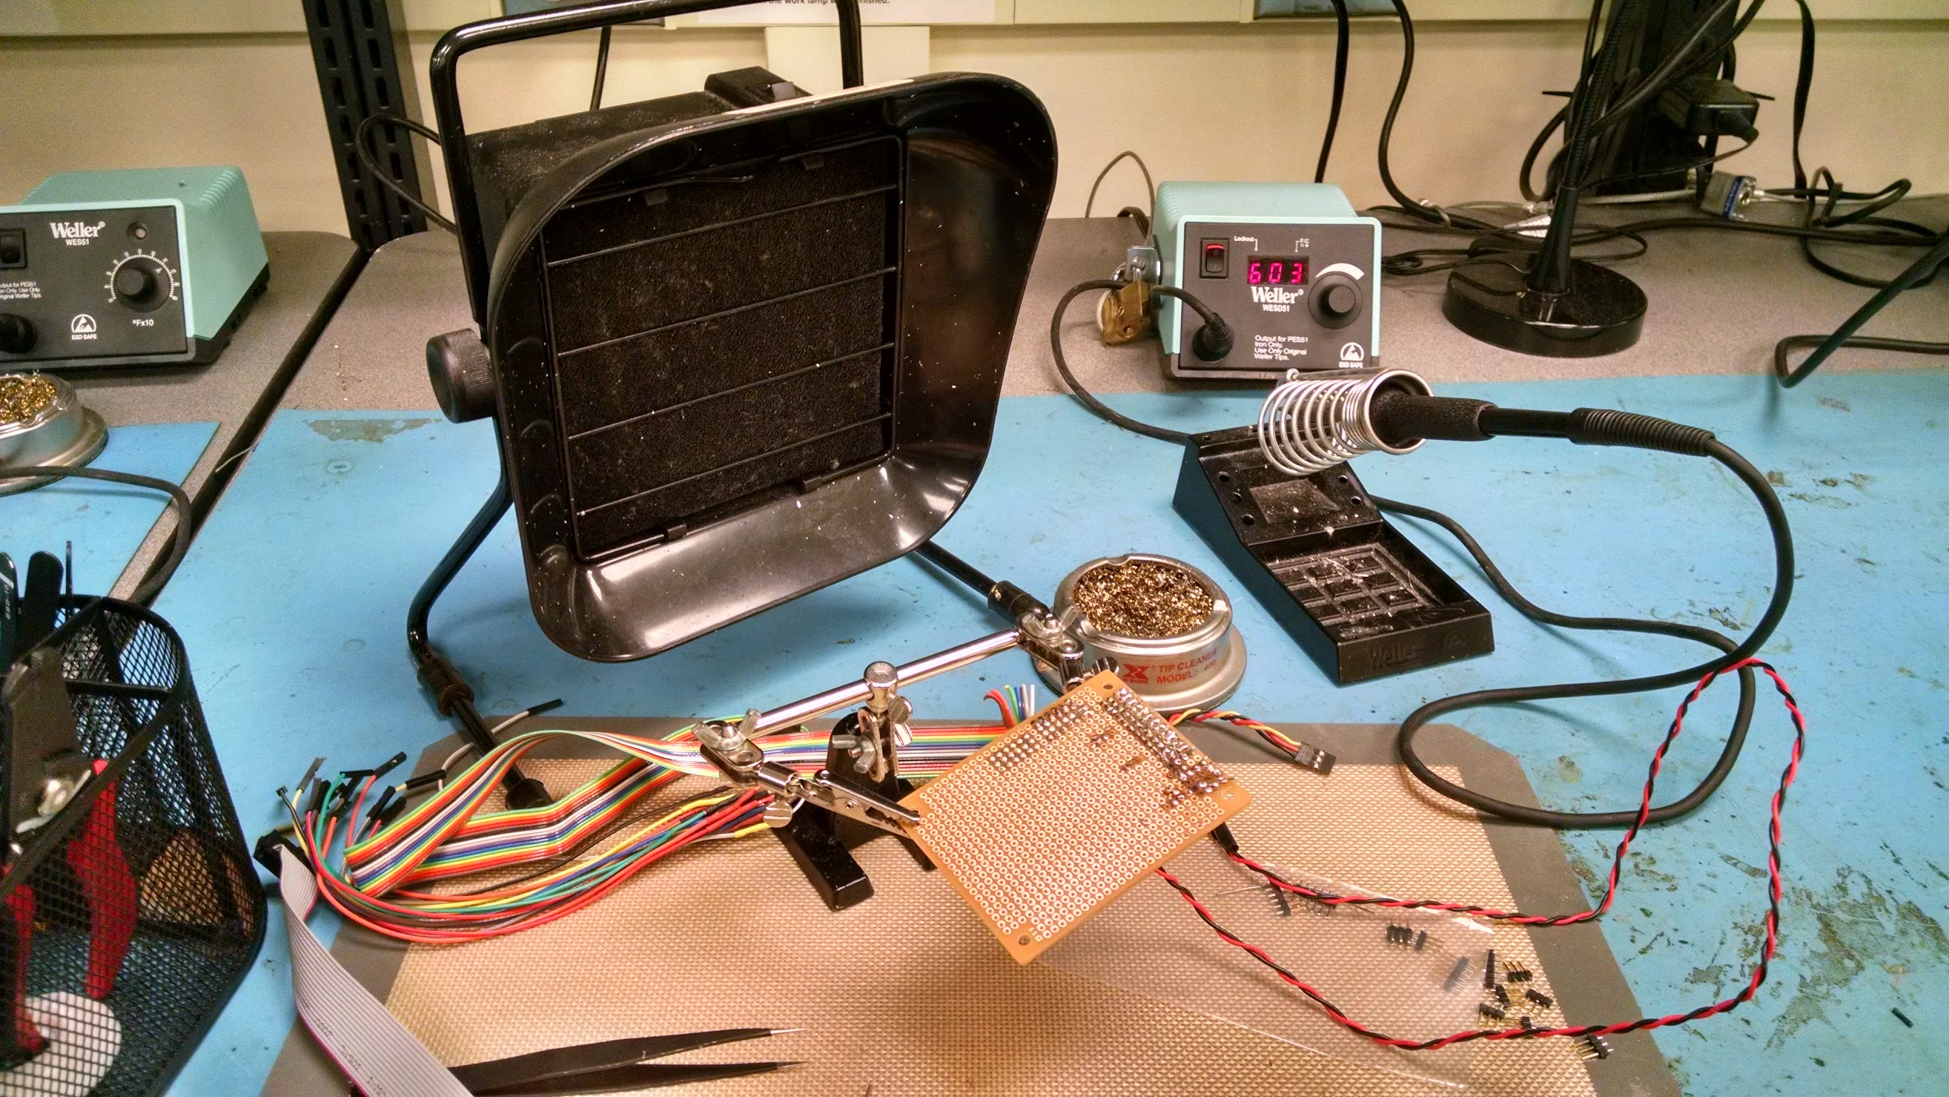
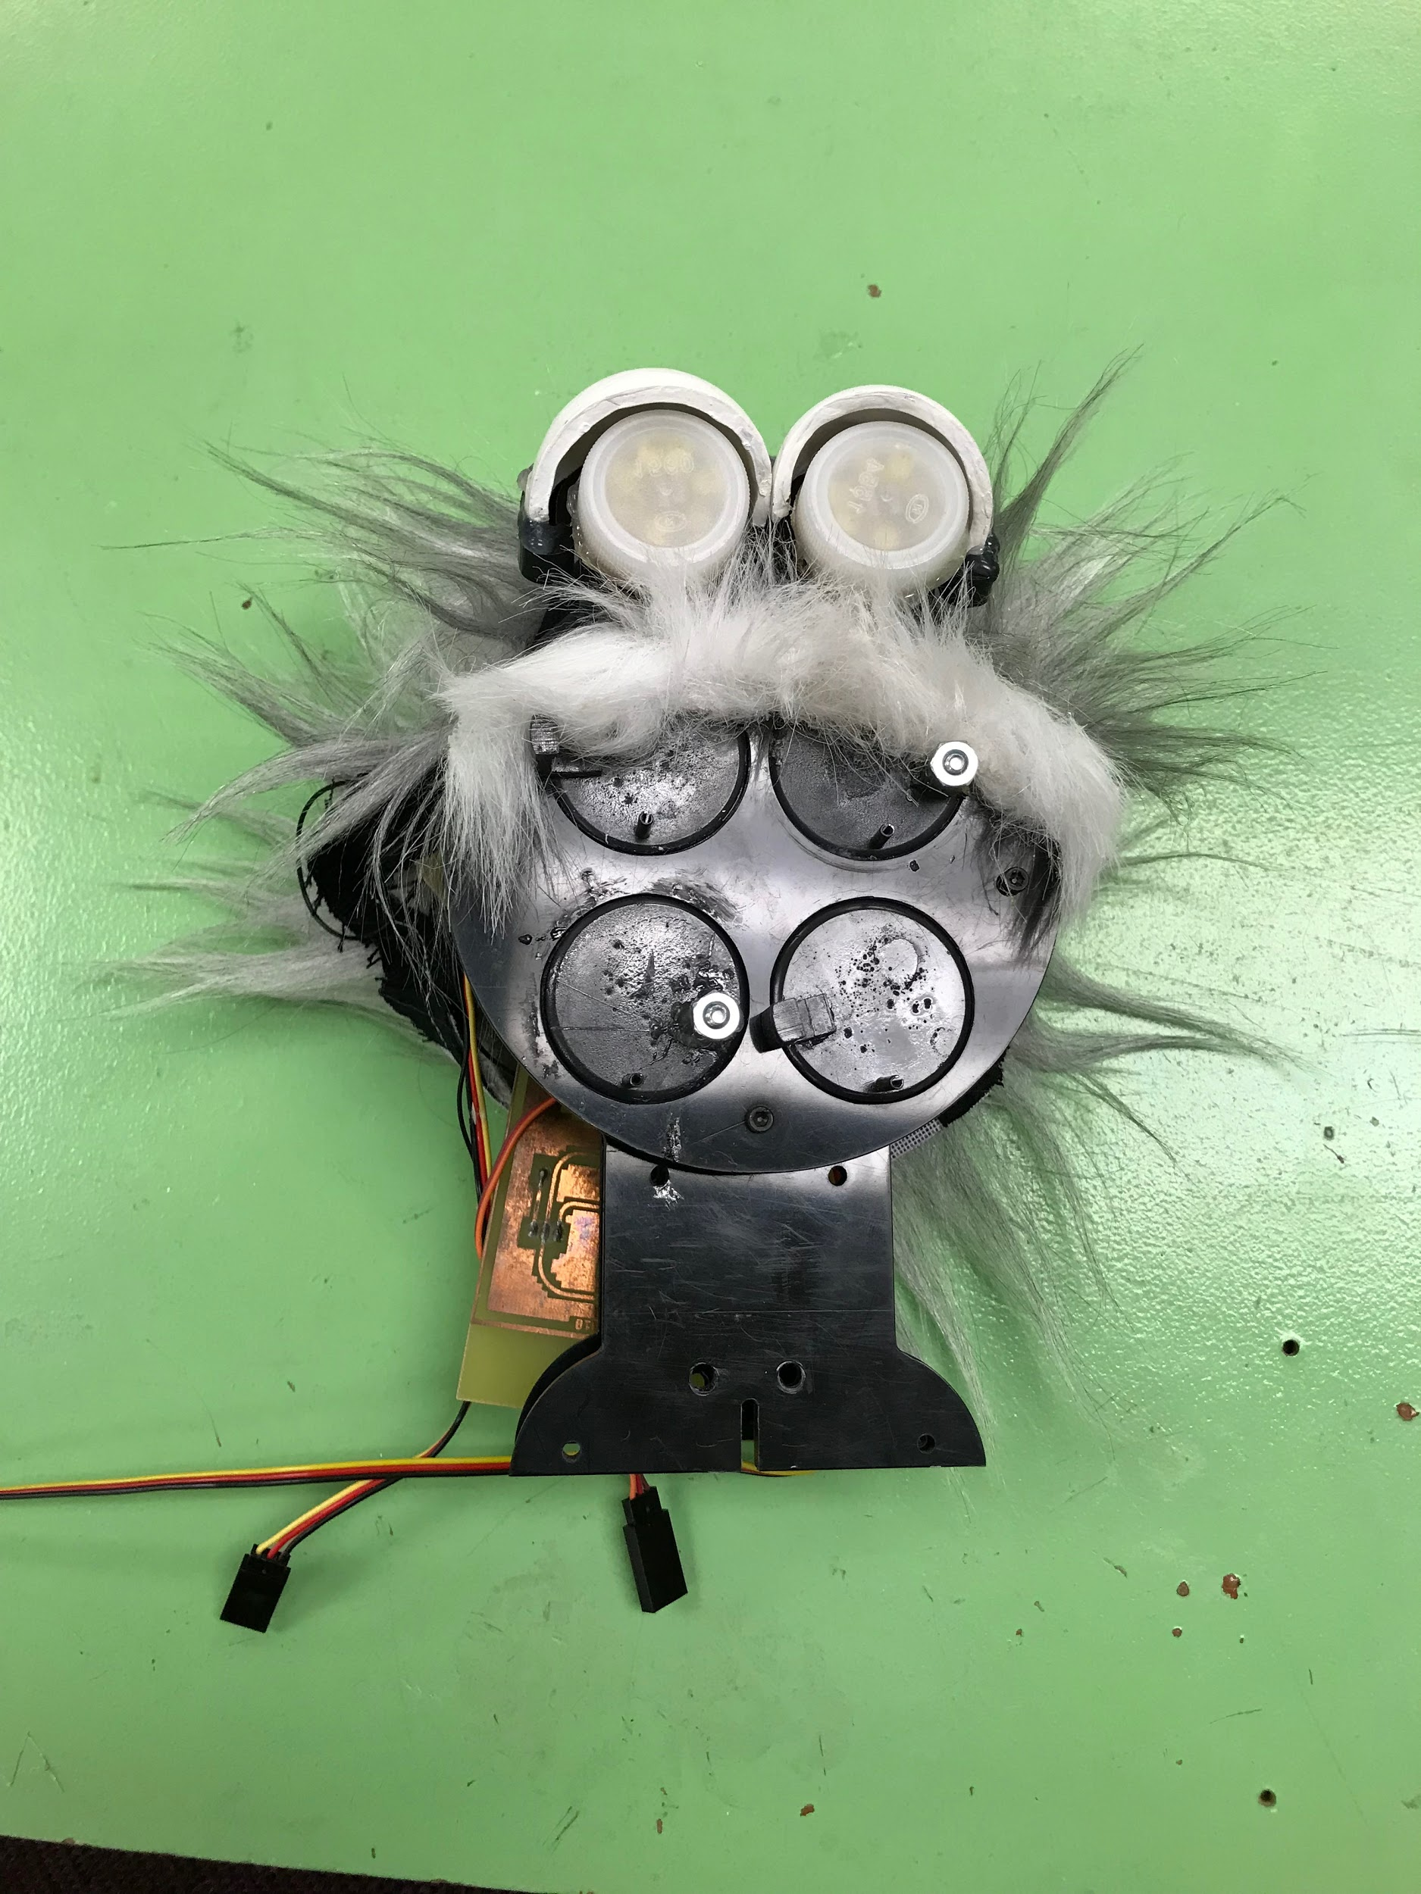
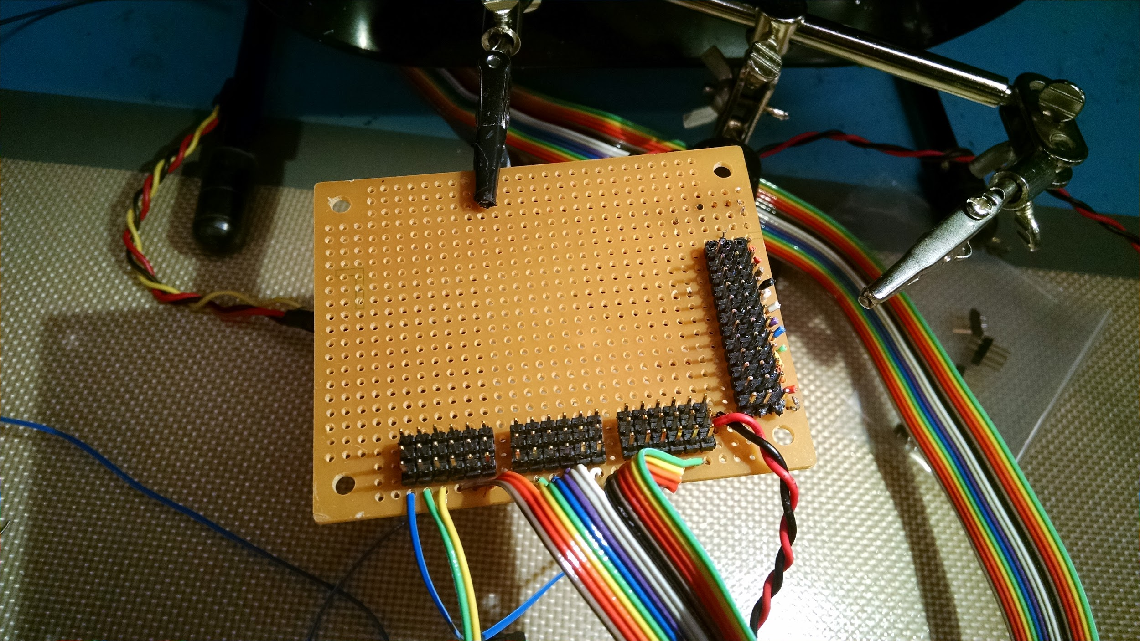
After Pictures

Slide 7
Text to Speech - Past Work / Our Design
The robot did not have any text to speech capability
Raspberry Pi3
Espeak
Python code
espeak -ven+m1 -s200 -g10 ‘Text’ 2>/dev/null

Slide 8
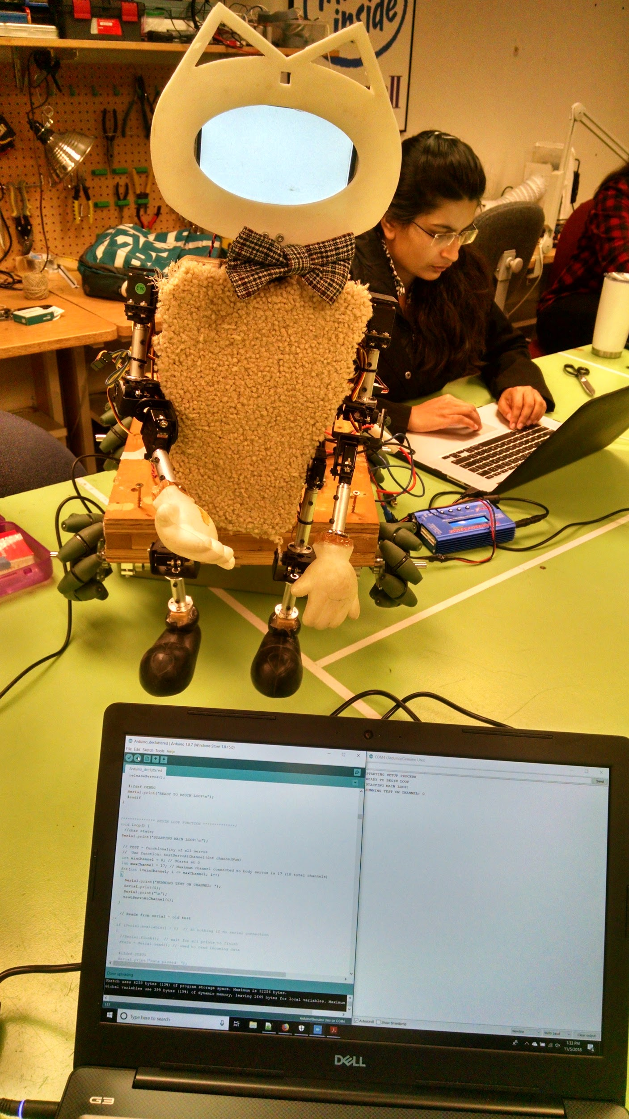
Text to Speech - Challenges / Future Work
Choosing voice speed, pause, and gender
Find a more realistic voice
Speech to Text
Bring a speaker to demo

Slide 9
Face and Object Detection - Past Work / Our Design
Face detection - Haar Cascade face detection
Mouse detection - HSV green Color detection
Both algorithms work on images captured from camera connected to raspberry pi
Used OpenCv, python, ML algorithm

Slide 10
Face and Object Detection - Challenges / Future Work
As computation on raspberry pi increases, frames per second reduces resulting in delayed reaction
Tracking of mouse needs to be done
It only detects person but not recognize
It does not take any action when it sees person and mouse it just speaks
Communication between arduino and raspberry pi to control robot needs to be done

Slide 11

Face/3D Printing: Past work
Old Face was an ESRA: Expressive System for Robotic Expression.
Did not resemble a Cat, and animation capabilities were limited
Difficult to change or update for future iterations of the Schrodinger’s Cat Robot

Slide 12
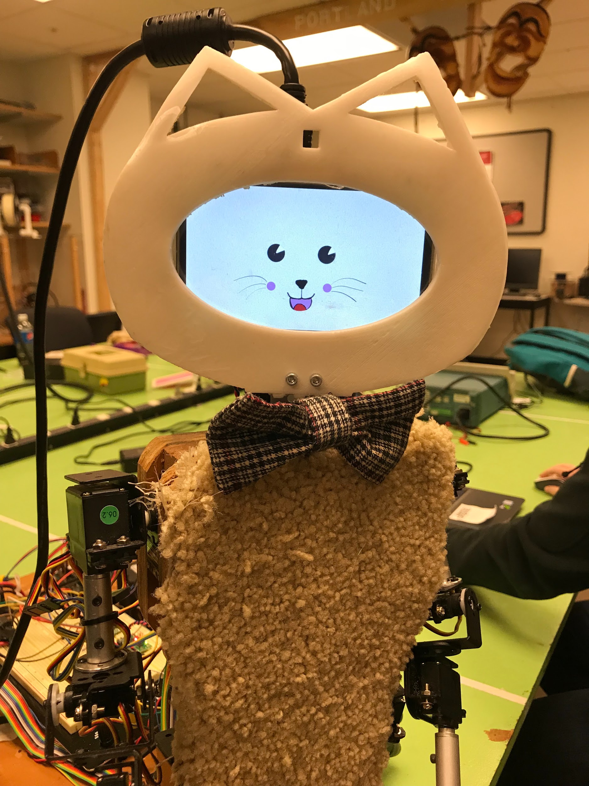
Face/3D Printing: Our design
Our head utilizes a LCD display framed by a 3D printed face.
3D printing and using digital animation allows the design to be more flexible.

Slide 13
Face/3D Printing: Challenges
3D Printing
Failed prints. Our design was large for the 3D printer in the Robotics lab. Uneven heat on the print surface allowed portions of the cat face to curve up.
Print resolution. My design allowed for +/- 2mm. This was too narrow.
LCD display and Animation:
Raspberry pi would not fill display.
OpenCV image display commands would not take ownership of display.

Slide 14
Face/3D Printing: Future work
Separate design into smaller pieces. Print separately.
Update design to increase margin of error resulting from low print resolution.
Develop more sophisticated animation.
Utilize touchscreen features of display.

Slide 15
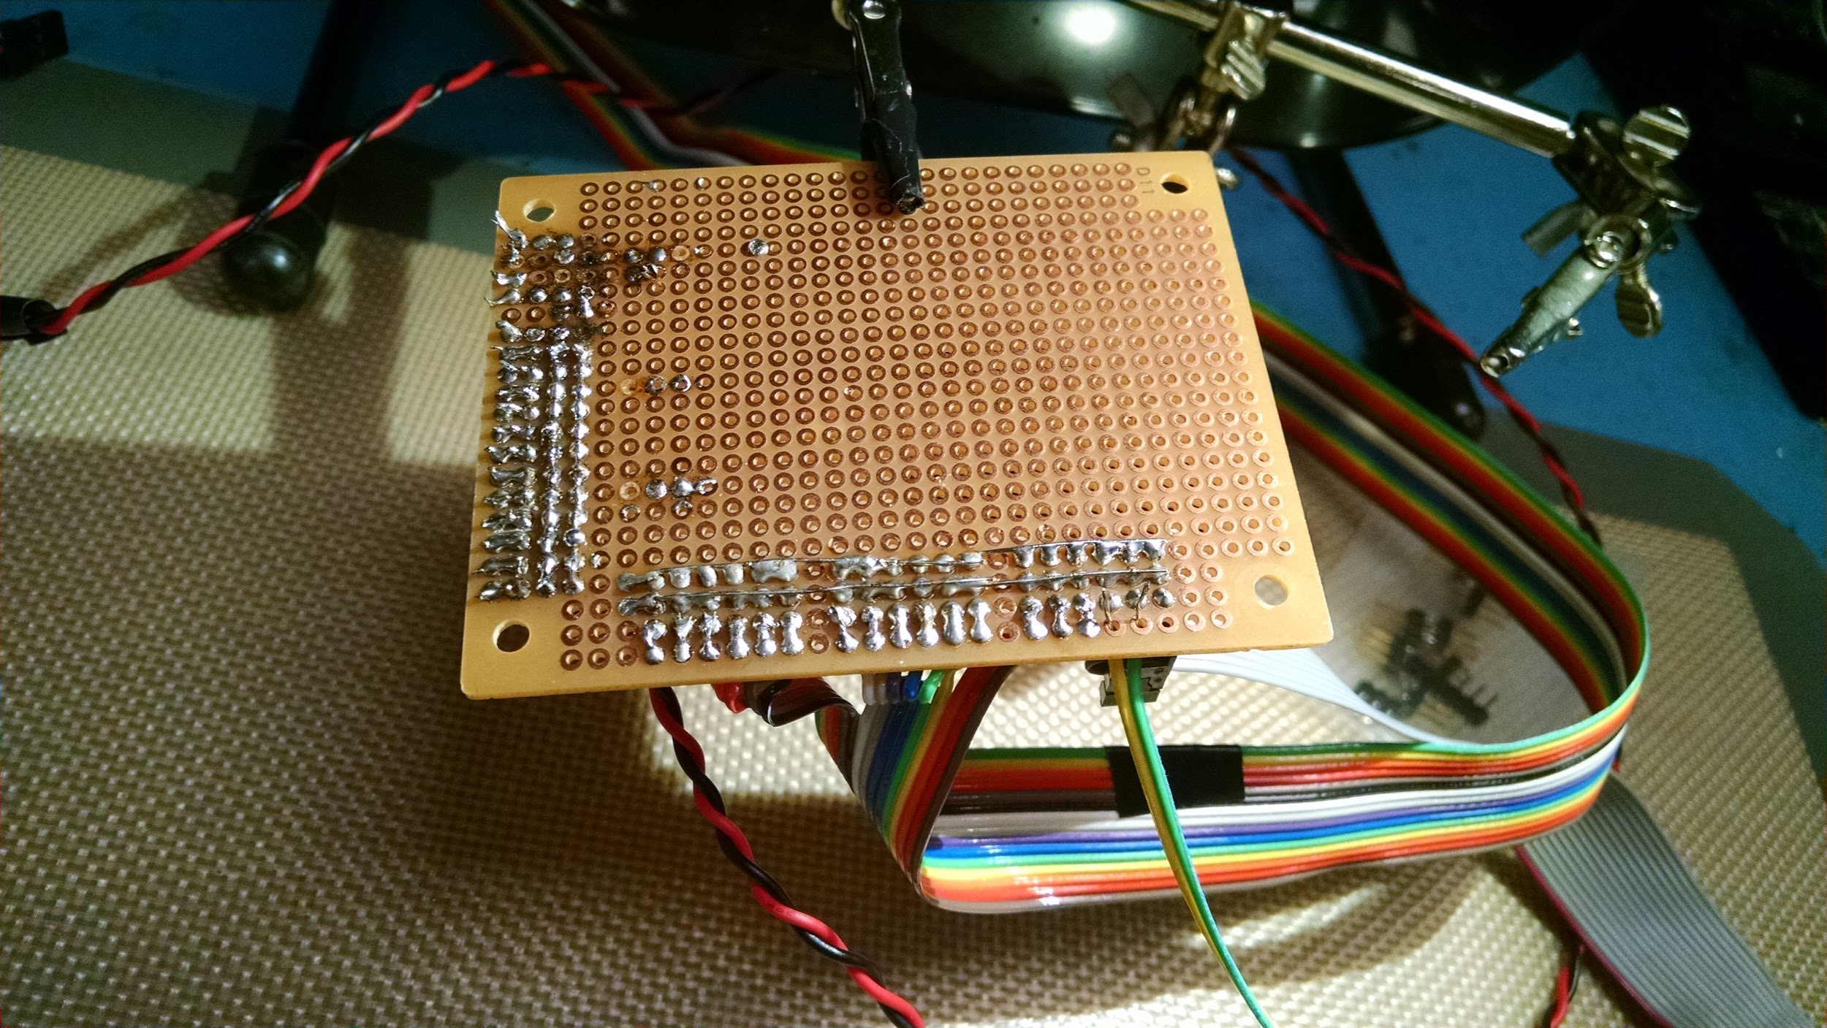
Servos: Robot Hardware
Robot body has 15 Servos:
4 for each arm (Forearm, Elbow, Shoulder Up/Down, Shoulder Twist)
3 for each leg (Knee, Hip Up/Down, Hip Twist)
1 for neck
Robot had additional servos for facial expressions that were removed for the construction of the new head
Servos are controlled by a Pololu Mini Maestro servo controller, which receives instructions via serial connection from the Arduino Uno
Arduino contains functions that implement gestures and behaviors (waving, turning the neck, etc)

Slide 16
Servos: Challenges
Servo connections to Pololu board were faulty. Had to resolder whole system
Previous servo mappings and definitions were incorrect or no longer relevant
All previous animation
Multiple servos are dead and barely move or do not move at all
Arduino was supposed to connect via serial connection to the Raspberry Pi to receive instructions. Was not working reliably by the demo presentation.

Slide 17
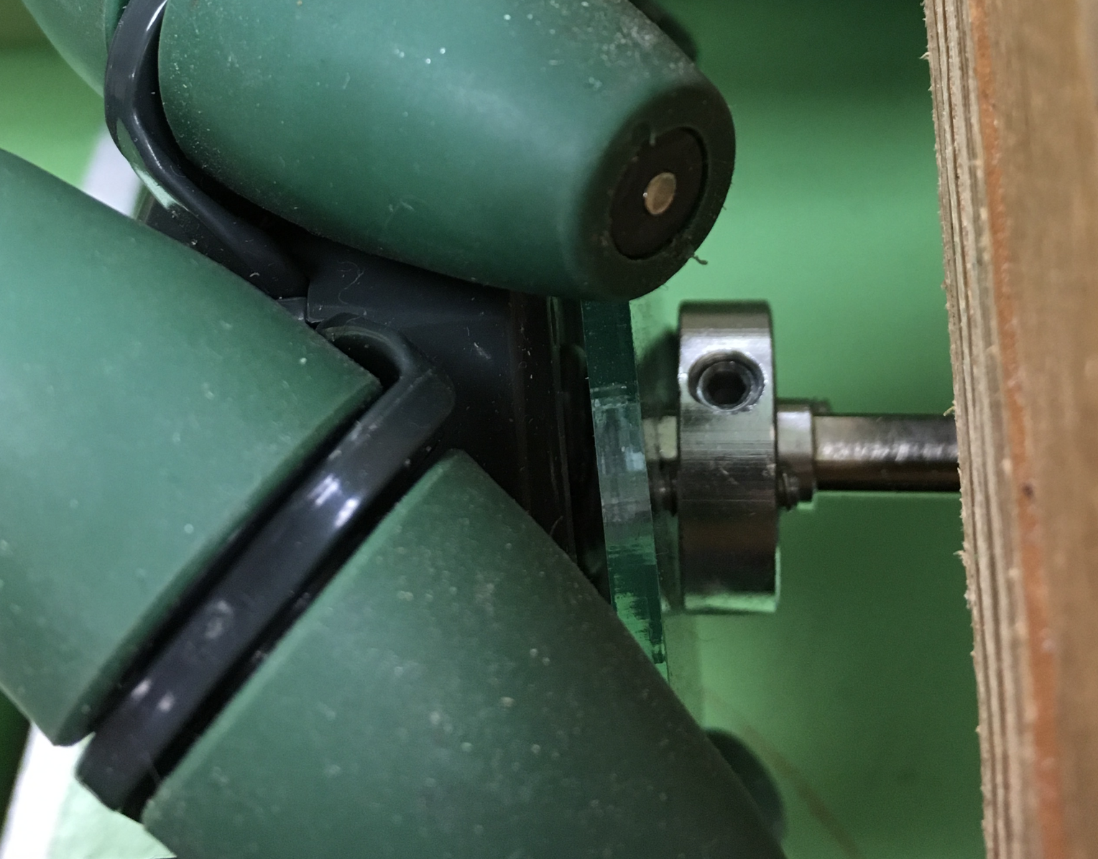
Omni-Wheels:
Pololu Qik 2s9v1 Controller :
Wheels controlled by two Pololu Qik 2s9v1- dual serial motor control.
Two Qiks are daisy chained to the Arduino for serial communication.
Variable speeds with PWM - 31.5kHz, 15.7kHz, 7.8kHz, 3.8kHz
Settings: 115200 baud, 31.5kHz, device ID - 9.
Challenges: One of the Wheels was wobbling, had to remove and fix it again.
Controlling the angles for turns.

Slide 18
Omni-Wheels: Future work
Controlling the angle of left/ right turns.
Develop smoother movement control and integrate vision and motion control.
Control Lateral left and right movements of the base.

Slide 19
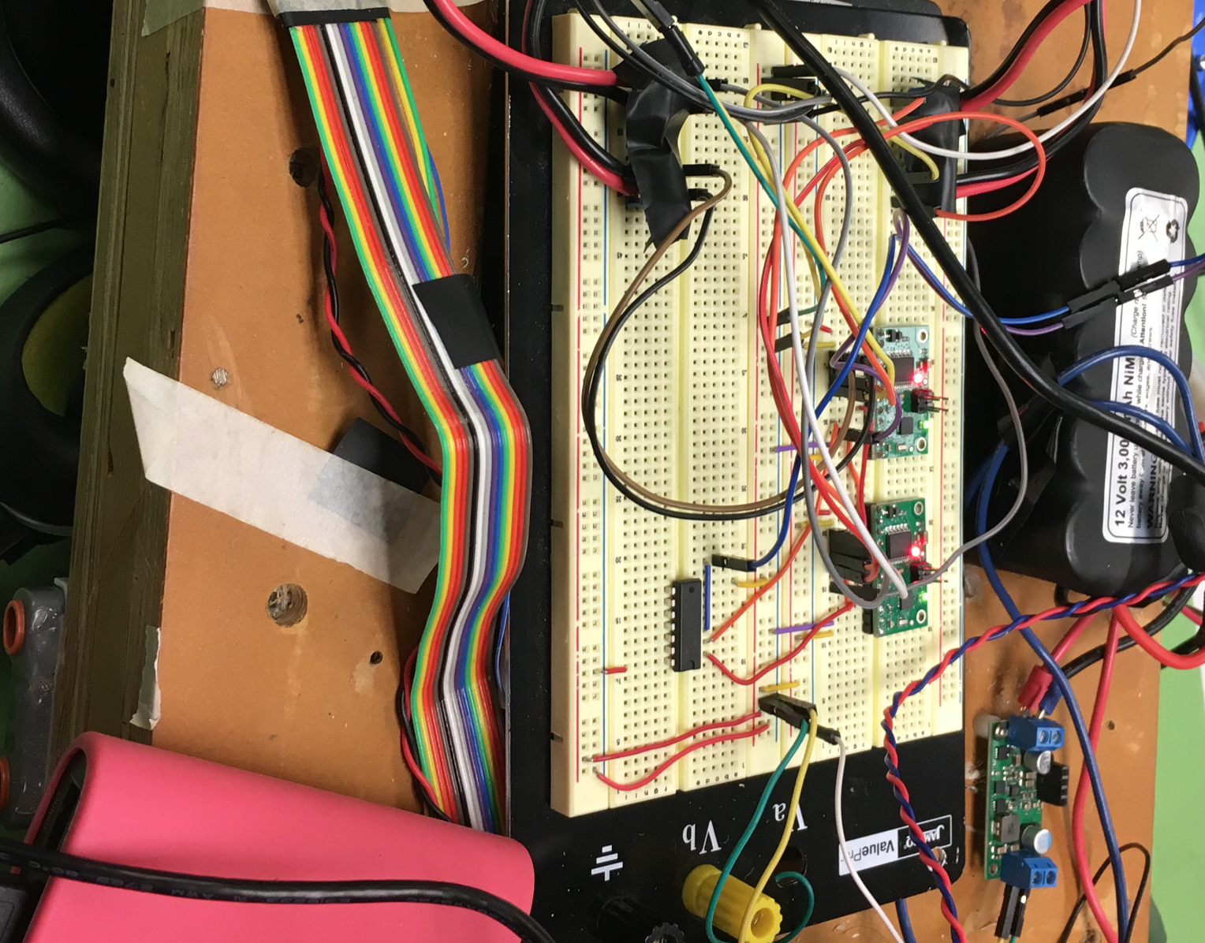
Challenges with HW
Breadboard on the robot was completely rewired as the one of the component (NAND GATE IC) had failed. This resulted in the Battery dead for a few hours.
The connections on the breadboard were loose and not reliable.
Previous teams had extra not used HW.

Slide 20
Demo

